Slide 1

Group Informatics: Design, Research and Blended Data Methodologies
Sean P. Goggins, Ph.D

Slide 2

Data
Analysis
Methods
Computation
Theory
Finding Connections – Animals? People? Snowmobiles? Overwhelmed.
The beach is different than the frozen tundra – But they both have footprints!
A rescue patrol has different needs than a tourist
What is our theory for *guessing* whose steps to follow?
Notes:
Knowing where others have been is of tremendous value in some situations. If you are dropped in the Wilderness of Alaska, following footsteps could save your life. I started my research trying to understand how small groups come together and work when there is little evidence other than discussion that they are even together. As I studied these groups, I came to recognize four dimensions of their interactions and their behavior that are distinct from small groups that exist in the face to face world:
Finding implicit connection is difficult, because most systems do not log and report implicit connections; by which I mean acts of reading or sharing the same artifacts, etc.
Identification with the group is powerfully influenced by the participants, but also by other experiences we have had in different kinds of technologically mediated groups. We all learn what to expect from each other in face to face social settings and adapt. In the online world, these adaptations are different in each technical system; and each individual has an array of technical systems they become familiar with …. That shape their expectations and perceptions of each new system.
Github
Sourceforge
Most research is domain bound. I can read studies of online learning. I can read studies of distributed software organizations. Few studies cover more than one context and almost as few researchers systematically examine multiple contexts – The idea of thinking about technologically mediated groups in a domain and system agnostic way is little explored. This problem takes on two distinct forms in two fields I participate in
CSCW – A lot of research on a small set of massive social computing systems
CSCL – A lot of research focused on small, microstudies of systems that are not widely distributed or used at all. I call these the “artisan cheeses”. Most learning design is built around systems that are the artisan cheeses – made in limited quantities, facing obstacles to scalability
The connection between activities that are logged in these systems and existing theories are not executed systematically across studies even within a domain; again, making comparisons and innovation more difficult.

Slide 3


Prominent, Contemporary Example: MOOCs
Learning Technologies We use
Technologies We Use Every Day
How do we get from A to B?
Pain
Fun

Slide 4


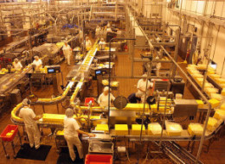


State of Learning Technology Design
Learning Technologies We Use
The Technologies We Design And Research
Massive
Unfriendly
Artisan Cheeses
They do not scale

Slide 5
A Pragmatic Path
Signal and Noise
Group Informatics
Questions
Theory
Probability
Construct
& question
Specific
Design based Research
Traces & Design
Notes:
From a design perspective, "big social data" is a way to frame how we make sense of the rich electronic trace data (logs) that are left behind in various learning environments; and then to use those logs to provide useful feedback to people about the learning that is taking place. Partly this is a social theory of learning framing, which is what my 2009 dissertation examines. In the four years since that once in a lifetime (for me) project, the scope of my inquiry has expanded to fields of software engineering, social media, computational linguistics, "big data" and virtual organizations. Furthermore, I have taken up projects focused on workplace learning and rural outsourcing firms that train their own workers. Why? Simply put, there is not enough signal solely in the study of how people learn in traditional, school focused contexts to identify the design ideas that are likely to push learning technology design forward to a breakthrough.
There are also institutional obstacles to the application of data science to learning that arise from learning technologies that are already in place. In one widely rejected article I wrote with Jonathan Foster, and which we each abandoned for different reasons, I argue that a fundamental issue in the slow market innovation of novel learning technologies centers on infrastructure. Not the first level technical infrastructure, or the second level process and interaction focused infrastructure, but infrastructuring around resource allocation within educational institutions. To date, we experience specific difficulties in trying new things at an institutional level because the human and capital costs to change are prohibitive. It takes time to turn a big boat, even at sea.
Given the institutional limitations, and my own ambitions for advancing learning technology through the systematic study of how people interact, form groups and build institutions in a virtual world, I have spent a number of years examining contexts outside formal learning environments. The work that is published and in progress brings a novel and I think important perspective to learning technology design. A perspective born of the deep study of how people learn in informal contexts; how non-learning focused virtual organizations function; and how people use social media to argue, share information and build connection in ways that we frankly do not yet understand.
I think one key, as it relates to "Big Social Data", is that if you want to understand learning and make learning technology better, you have to study how people learn. And that's mostly not in school. If you want to build better learning technology, you have to study technology people use and how they use it. And that's mostly not Blackboard or systems like it. IMHO.
----- Meeting Notes (1/21/13 19:25) -----
When you use the work example, point out the failures of the education system being studies not having impact in workplace or out of school environments…
Relevance to stay engaged is important … CSCL@Work feeds back into my fundamental approach that suggests that to discover learning where it is occuring…

Slide 6

Learning Technology Design
Design
Research
“If you build it, they will come” – Kevin Costner’s character in Field of Dreams
“Supposing is good, and finding out is better” – Mark Twain
Infrastructure
Resources appear, too, as shared visions of the possible and acceptable dreams of the innovative, as techniques, knowledge, know-how, and the institutions for learning these things. Infrastructure in these terms is a dense interwoven fabric that is, at the same time, dynamic, thoroughly ecological, even fragile. —Bucciarelli, 1994, p. 131

Slide 7

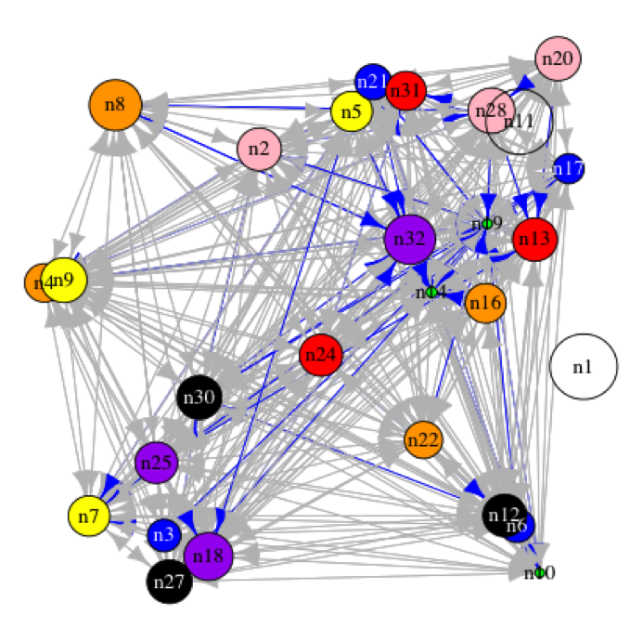
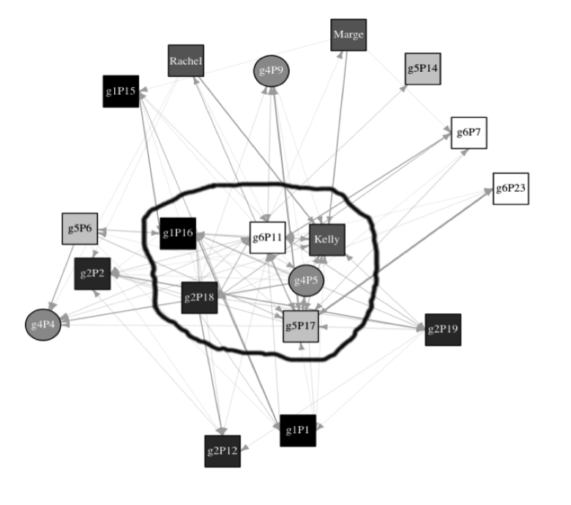
Leadership
Coordination
Knowledge Construction
Information Diffusion
Discourse
Negotiation
Knowledge Transfer

Slide 8
Group Informatics: An Ontology and Methodological Approach

Slide 9
What Does Group Informatics Draw From?
Theory: Selection is Context Driven
Data: Electronic Trace Data
Unit of Analysis: The Interaction
Methods Woven Together:
Grounded theory
Content analysis
Network analysis
Computational linguistics
Group informatics is the
systematic application of social network and set theory oriented methods** for analysis of online, human trace data,
skepticism about the reality presented by analysis of raw trace data, and
the integration of other, context relevant social computational methods and approaches,
in concert with established and emerging qualitative approaches
to produce reliable and repeatable science in the study on online phenomena.

Slide 10
The Group Informatics Path
Inductive Research
Qualitative
Quasi-Experimental
Abductive
Phenomenological
Design Experiments
Ethnographic
Increasing Generalizability
Drawing Inference from Electronic Trace Data (Logs)

Slide 11
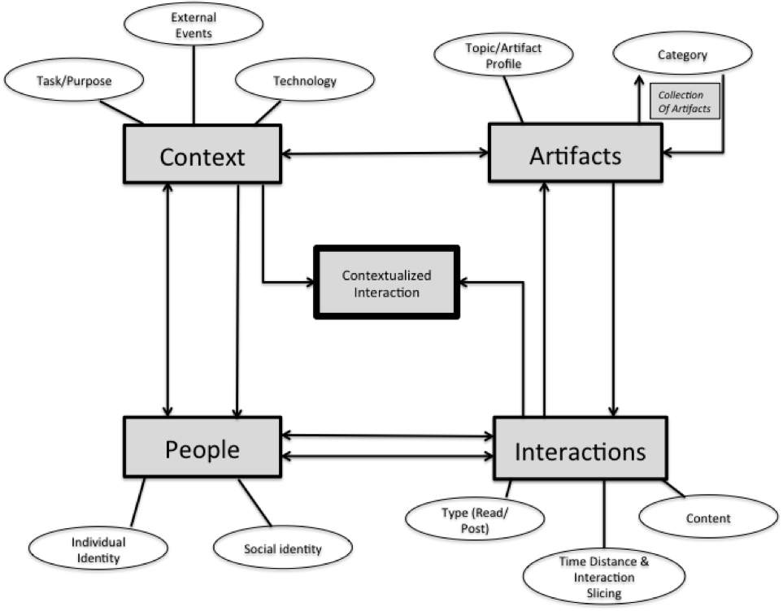
Group Informatics Ontology

Slide 12
General Group Informatics Methodological Approach
Discussion Post
Open Coding
Connect to Theory
Time proximity
Topical proximity
Classification
Read
Response
Axial Coding
Aggregation of Posts by Topic, time or other
Weighted Network Analysis of Interactions
Notes:
This slide would benefit from a key.
Also get rid of white on black.
----- Meeting Notes (1/21/13 19:25) -----
This slide is hard to read. Fix that.

Slide 13
Studies Across Contexts
Group Informatics / SNA
Key Constructs: Discourse, Coordination, information diffusion

Slide 14
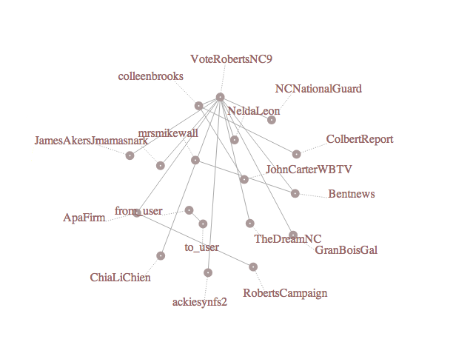
Live, Topical Twitter Networks

Slide 15
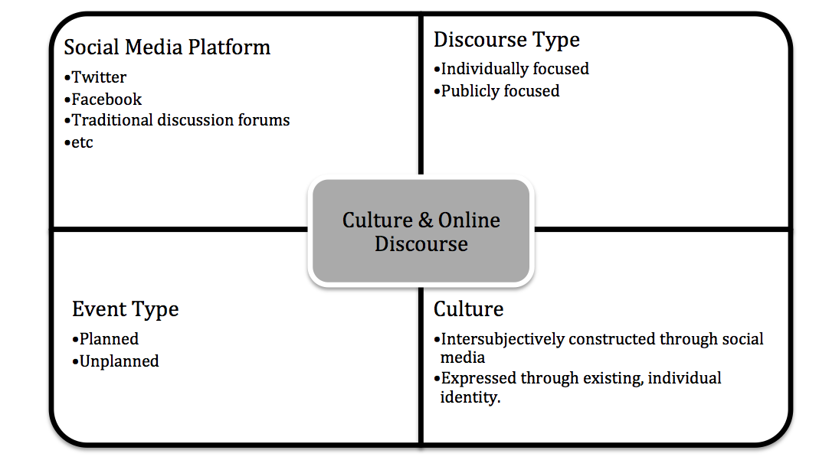
Big Social Data: Framing the Problem
Challenges
Studies Across Contexts
Applying Lessons in Learning
Examining Log Data

Slide 16
To Sum Up Group Informatics: Probabilistic Thinking to Instrument Learning and Information Behavior
Theory
Hypothesis
Data
Skepticism about your findings

Slide 17
Group Informatics in Design
Learning Technologies We use
Technologies We Use Every Day
My Approach
Building Measures and Indicators: Research Collaboration Technology in Learning Intensive Disciplines … where people are using that technology … so that we understand what works.
How do we get from A to B?
A
Pain
Fun
B

Slide 18
Social Network Analysis
GOAL: Begin a discussion of Big Social Data
Activities
Talks looking Group Informatics; but also Rich and long social data
Collection
Analysis / Summarization
Specifics:
Data Collection
Network Analytic Techniques
Twitter Collection and Analysis
Inciting Discussion of Methods and Opening the Creation of an iSchools Big Social Data Community Through the Github Repository – Don’t just be committed – Be a committer!

Slide 19
Key Concepts
Degree Centrality
Betweenness Centrality
Network Variance Over Time

Slide 20
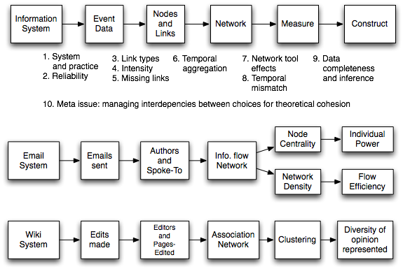
Validity
Diagram by James Howison

Slide 21
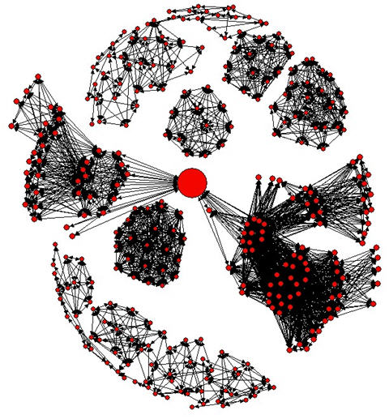
Betweenness Centrality: Finding it Online
Role and Name | Post Rank | Read Rank
APAN RFI Manager (Lucy) | 14 | 14
Government Contractor (Andrea) | 15 | 38
Senior GIS Specialist (Mike) | 35 | 58
NGO Executive Director (Ruth) | 26 | 468
Notes:
You want to find the people who get shit done.
There is a common behavior of people who are shilling for government contractors dominating these forums with post behaviors; they may have useful services, but they are not connecting people are efficiently moving information … They create a lot of noise … they want you to use their hammer to beat all the nails.
When government contractors see a disaster, they see dollar signs … as much as we want to think about these humanitarian causes being “good” … but there are company’s out to profiteer off of that.
The relationship between active information brokerage and forum use.
THIS IS
Lucy: APAN Request for Information Manager
Lucy is the Request for Information (RFI) Manager for APAN and her role was reflected in her network activity. Though Lucy’s title indicates that she is an important part in the network, she is still outside of the top 10 in both read and post data. She had the highest participation rate of the users we chose as exemplars. In total, Lucy initiated 44 threads that received 267 responses, and contributed to an additional 59 threads with a total of 285 responses.
Lucy had the highest betweenness score in the categories of GIS Information Provision and Medical, and also placed high in betweenness in many other categories including Military Coordination, Request for Equipment and Security Information Request. For these topics, Lucy is an integrative information gatherer and provider. One example of this behavior is Lucy’s use of information from one forum to assist a cruise line, asking in another forum where to send ships for temporary housing: In another Forum, “Control of Vessel Traffic in and out of PaP”, it is also stated that “the host nation has control of port traffic.” Further it reports that the number that was good before the earthquake was [ommitted]”.
Ruth: NGO Executive Director
Ruth, like Mike, does not post a lot. Her rank in forum activity for posts (#26) and reads (#468) would not cause her to be noticed without the approach we use; but Ruth plays an important and central role in one niche aspect of the APAN forum supporting Haiti relief. Ruth is the Executive Director of an NGO that helps assist local community residents recover from disasters. Ruth has the highest betweenness in the category Orphanage Assistance and was the third highest betweenness actor in the category Coordination of Online Efforts. Ruth initiated 20 threads that received only 83 responses, and responded to 18 additional threads, with 83 total responses. The fact that Ruth was an Hidden broker in those two categories surfaces her specialization. Her posts demonstrate that she focused on helping orphanages that were affected by the earthquake and coordinated online support for the relief efforts. This specialized activity is similar to Mike’s participation in posts focused on GIS. For example, Ruth is active coordinating relief supply deliveries with a new person in the field via APAN on February 3, shortly after international forces grow in participation (i.e., new people on the ground): Please let know when Susan returns from DR to PaP so that we may coordinate the kits to got to the clinics and orphanages we pre-designated.

